Slide 1

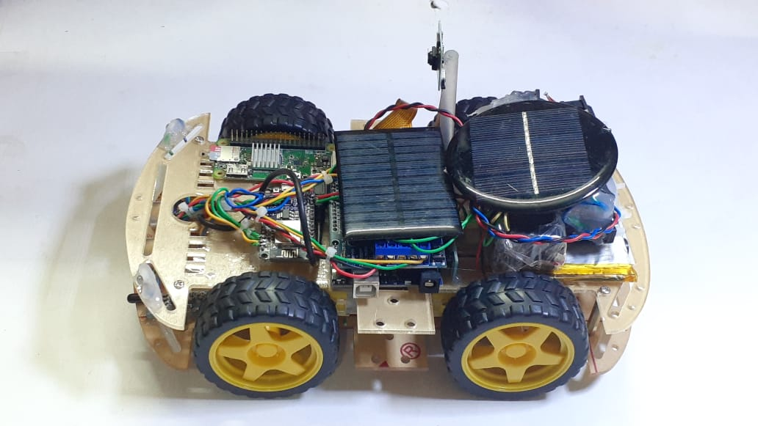
IOT BASED RESCUE BOT
PRESENTED BY-
2nd Year, Dept. – ETCE
DABANJAN SAHA
DRISHA MODAK
SUDIPTA BISWAS
THIRTHANGKAR BISWAS

Slide 2
INDEX
INTRODUCTION
CIRCUIT DIAGRAM
RESCUE BOT
APPLICATION
FUTURE ASPACTS
ADVANTAGE & DISADVANTAGE
CONCLUSION
REFERENCE

Slide 3
INTRODUCTION
PC based oscilloscope score over standalone oscilloscope due to their compact size, low cost and ability to do offline analysis.
It is made up of very few components, so that everyone can afford it. Generally, the cost of an professional tender is around Rs. 50000 to 1000000 is under the budget of Rs. 10000.
As it is re-programmable, if we have any issue we can change it so easily, at little to no cost.

Slide 4
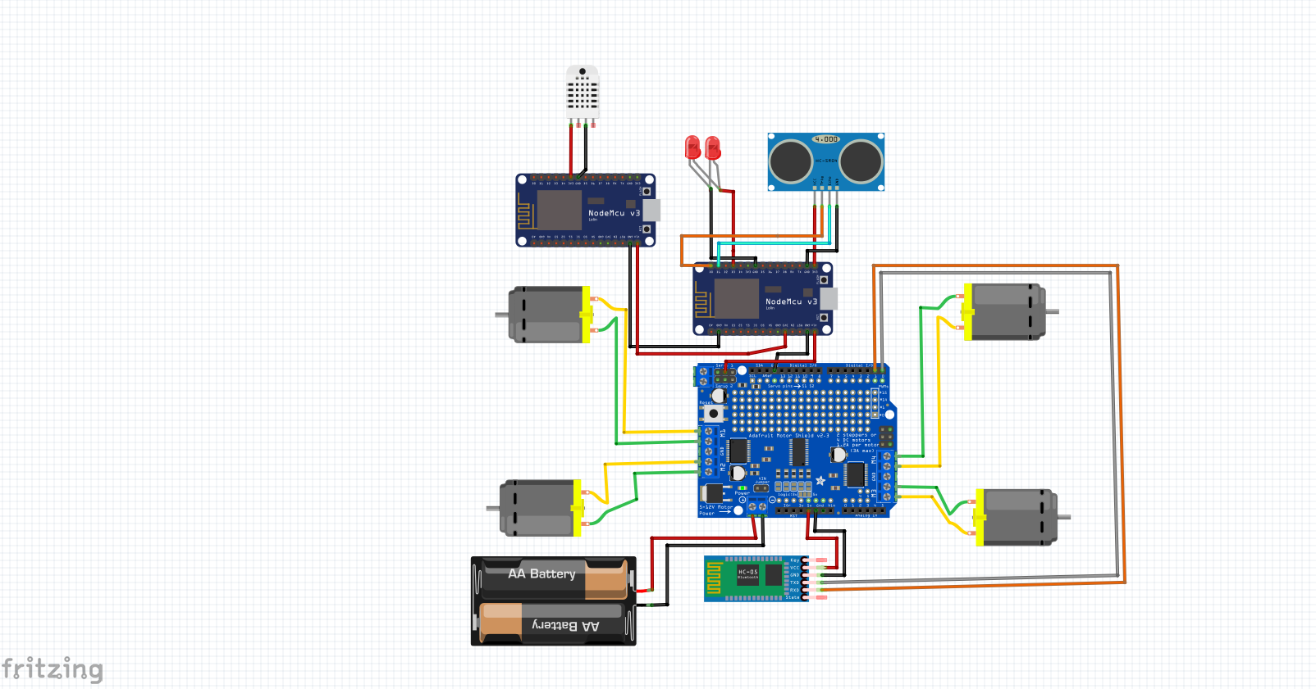
CIRCUIT DIAGRAM

Slide 5
RESCUE BOT
The name of our project is ‘Rescue Bot’. It is an ESP-8266 NODEMCU, Raspberry Pi Zero W and micro-controller based Tender are an essential tool for front-line rescue workers and professionals to conduct there work as expected, from a safe distance.

Slide 6
APPLICATION
1. It is to be used for rescue purpose in hearse condition where humans can not go in that condition.
2. It can measure temperature, humidity, distance, and show live footage in its separate controller.
3. It can charge automatically using solar power from its solar panels.
4. It is very easy and simple to use. It works by connecting it to the PC and not having any external display, just plug and use.

Slide 7
FUTURE ASPACTS
In future, we can upgrade our ‘Rescue Bot’ in many ways. First of all, it is having signal channel which we can later develop it into double channel. Secondly, also we can upgrade the software which will make it more advance. Thirdly, we can add storage memory, with the help of it data can be storage for a long time. Fourthly, we can add an arm to help it deal with enclose space(s) and to look more attractive and unique. Fifth, we will try to look more addition of more features to make it more accurate.

Slide 8
ADVANTAGES & DISADVANTAGES
Advantage
Disadvantage
The set-up is very easy to handle and straightforward.
It can charge its battery from solar energy
It is very low cost and compact, quite simple.
It will be used in Place(s) where humans are unable to Go .
The Bot can operate in any whether condition.
It is not accurate and having some % of error.
It don’t have the range of professional tender.
It’s frequency can be intercepted as there not encrypted.
It will only analyze in real time as there is no storage memory.
The bot can not run under conflict of information (frequency).

Slide 9
CONCLUSION
In This Project , We Learned the study of Raspberry Pi, and successfully made the pc based Rescue Bot, which is very helpful and an important electronics device. We gave our best to make this project “Rescue Bot” compact and in low cost under the budget of Rs.10000/-
We are very glad to complete this project with in the prescribed time and come across many new technologies. We want to convey our thanks to all who help us in different ways.

Slide 10
REFERENCE
https://en.wikipedia.org/wiki/Solar_panel
https://www.waveshare.com/wiki/DHT11_Temperature-Humidity_Sensor
https://en.wikipedia.org/wiki/NodeMCU
https://www.aspina-group.com/en/learning-zone/columns/what-is/001/
https://www.raspberrypi.org/products/raspberry-pi-zero-w/

Slide 11
THANK YOU!

